Slide 1
Duplicate Question Detector
Ben Marsh
June 6, 2023

Slide 2
The Problem:
Websites like Quora receive many duplicate posts
Users may wait for their question to be answered when the answer already exists on another post
Website resources are wasted on duplicate pages

Slide 3
The Solution:
Create a classifier model that can compare two questions and determine if they are duplicates
This can be implemented to automatically redirect users to existing answers

Slide 4
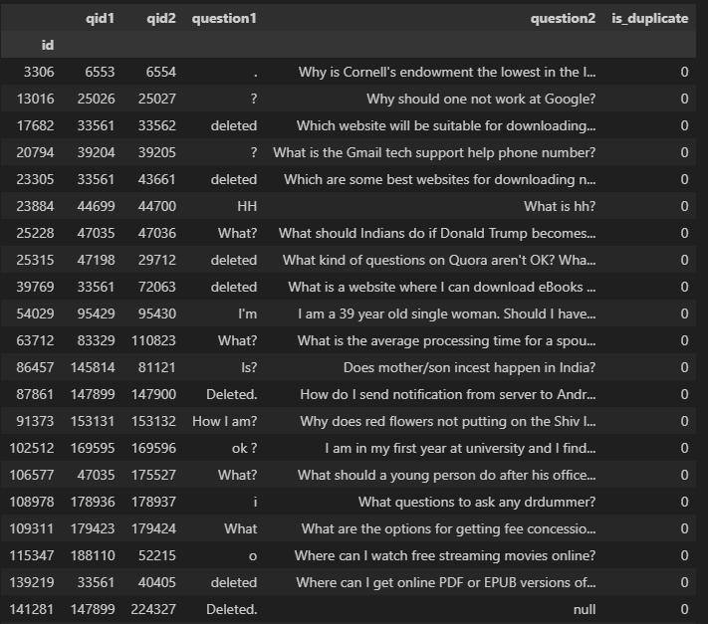
The Process
Data Cleaning and EDA
Feature Engineering
Ratio of words in common
Cosine Similarity of TFIDF Vectors
Cosine Distance of GloVe Word Embeddings
Model Training and Evaluation
Logistic Regression
Random Forest
XGBoost

Slide 5
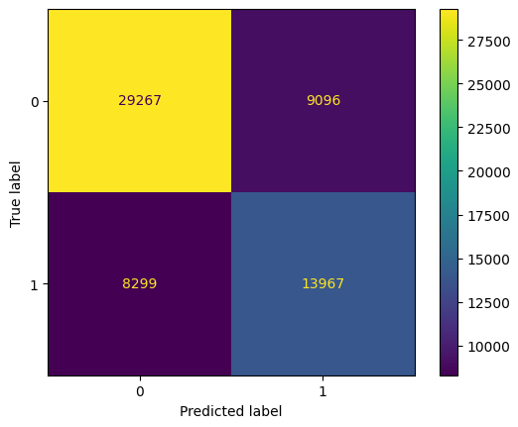
Results
Random Forest Classifier
Accuracy Score: 0.713
ROC-AUC: 0.70

Slide 6
Challenges And Future Work
Computer Resources – Not able to use actual embedding vectors in models
More thorough data cleaning – errors in labels, more nonsense questions
Oversample to address class imbalance

